Slide 1
Submitting a Data Request Service in SPARC
Table of Contents
How to submit a SPARC Request
Step 1. Choosing your service – 2
Step 2. The Cart – 3
Step 3. Creating a New
Research Study – 4
Step 4. Project Information – 5
Steps 5-9. Submitting your request – 6-8
Step 10. REDCap Email – 9
Step 11. Filling out the REDCap form - 10
Services
Types of Data Request Services – 11
Other Types of Services – 12
Contact Information – 13

Slide 2
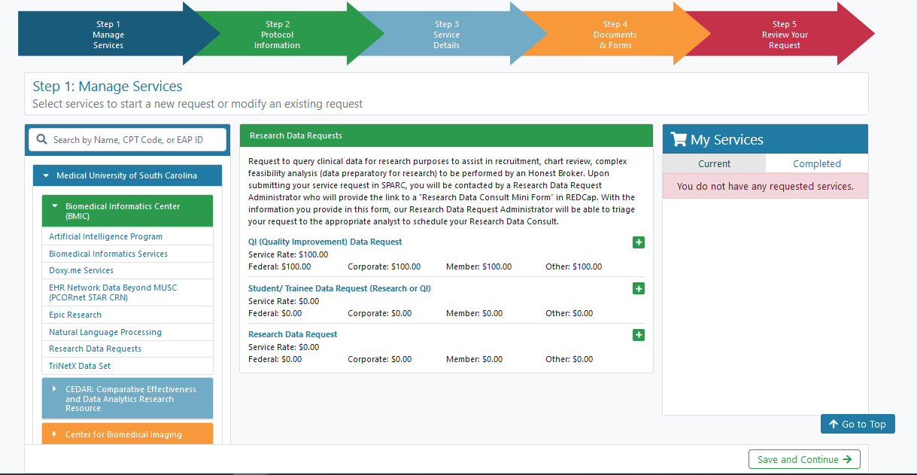
Step 1
Choosing Your Service
Your cart
Click 1
Choose the service you need and add it to your cart.
More info on each type of service is on page 11 of this guide.
Click 2

Slide 3
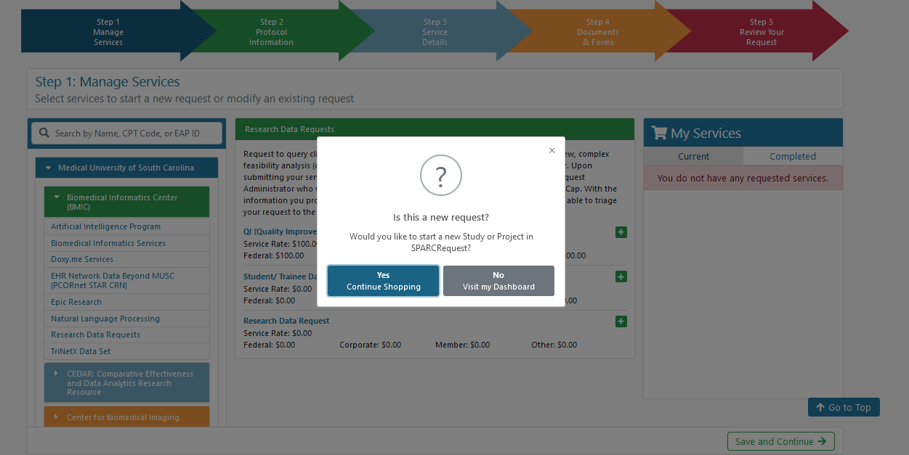
Step 2
The Cart
Click yes if you’re starting a new study
Click no if you want to add this request to a previous study
Click continue after you make your selection

Slide 4
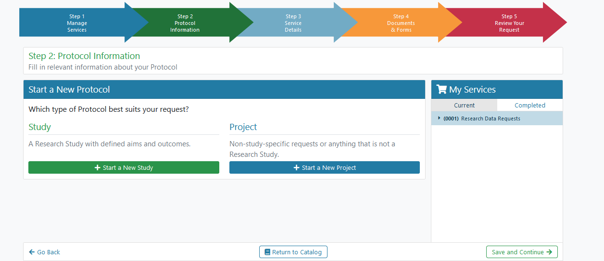
Step 3
Creating a New Research Study
If you clicked ‘Yes’ on the previous screen, you will be brought here
If you clicked ‘No’ on the previous screen you will be brought to SPARCDashboard. There you will be able to find your study and add this request to it.
Click New Study. Then fill out the information about your study on the next screen.

Slide 5
Step 4
Project Information
Fill out your project information. If you chose New Research Study, you will have more information to fill out.
Your MUSC ID

Slide 6
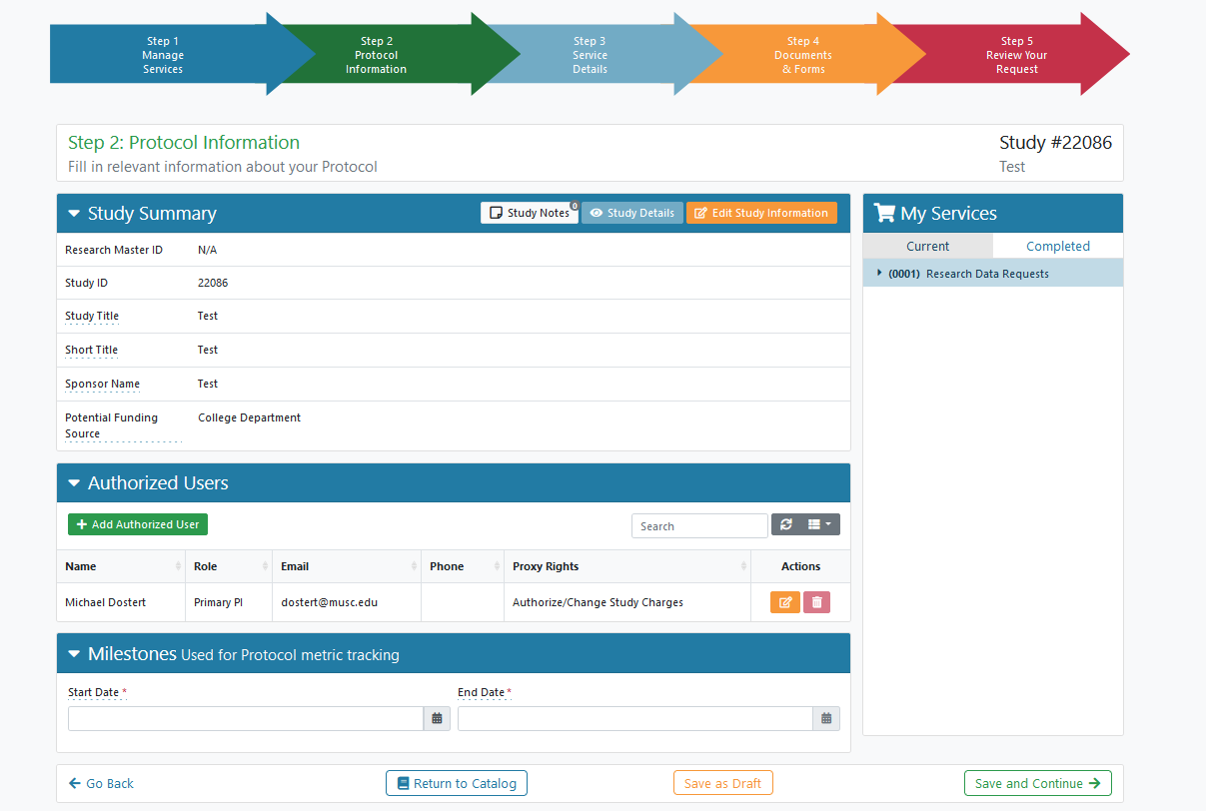
Step 5
Submitting Your Request
Here you can view information about your request and assign additional details
Add a Start and End Date
Click Save and Continue

Slide 7
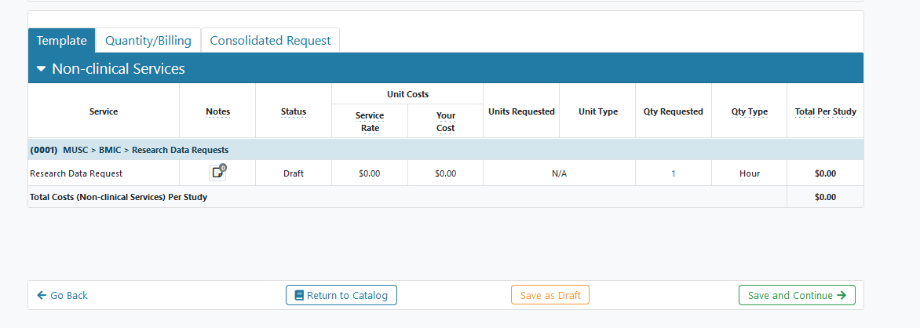
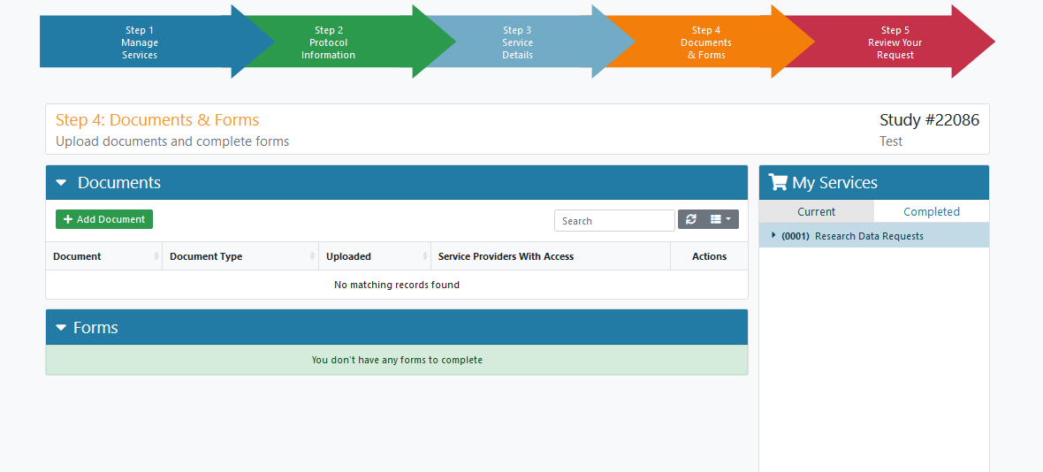
Step 6
Submitting Your Request
View the cost information about your request
Click Save and Continue
Step 7
Upload any documents you might have
Click Save and Continue

Slide 8
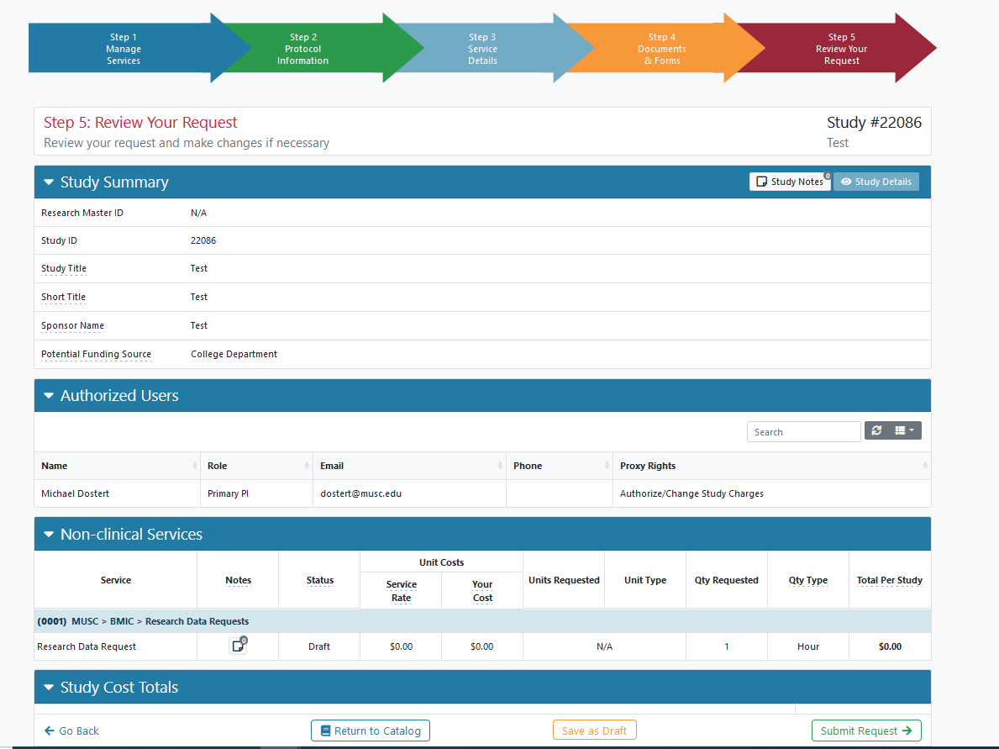
Step 9
Submitting Your Request
This is the final screen to edit any information about your study.
Make sure to click Submit!

Slide 9
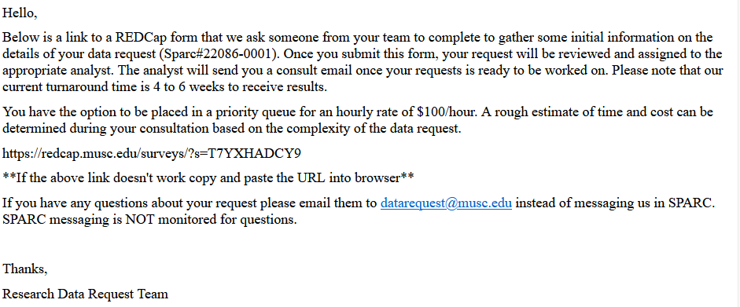
Step 10
REDCap Form Email
Email Example
After submitting your request you will receive an email from datarequest@musc.edu. In this email will be a link to a form to fill out to tell the Honest Brokers more about your request.

Slide 10
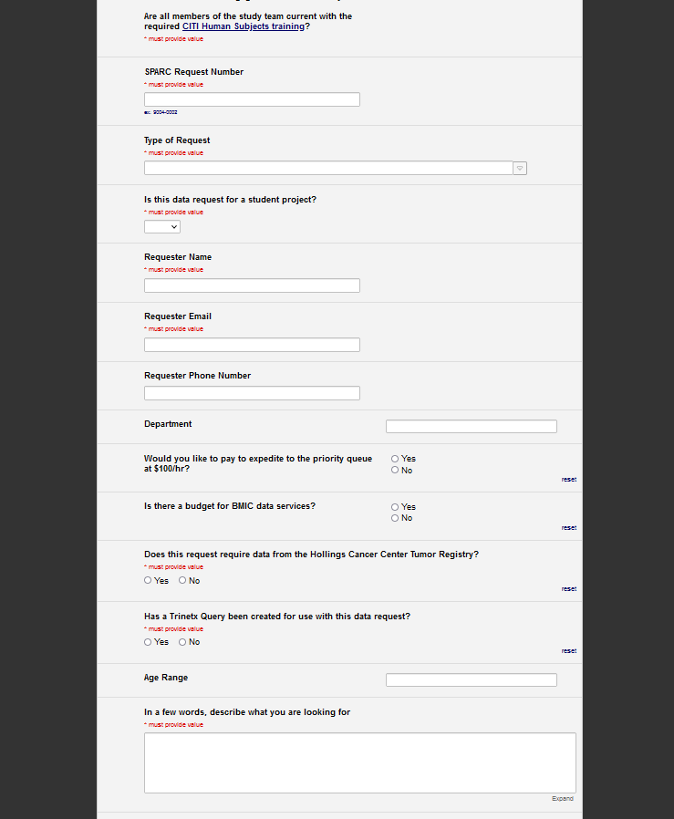
Step 11
Filling Out the REDCap Form
The SPARC number from the request you submitted. It looks like 12345-0001.
Your REDCap form will look like this
Type out any useful information for the Honest Brokers like your inclusion criteria and data elements to return for the patient set.

Slide 11
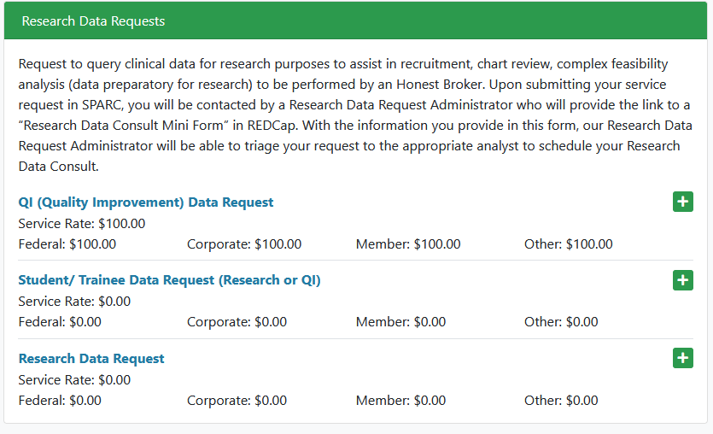
Types of Data Request Services
QI: This fee-for-service request facilitates data extraction for non-research, quality improvement, analytics, or operational purposes. Your total cost estimate will be given to you after we have a chance to review the request. You will only see the hourly rate at submission. You can check to see if your project is QI by taking this survey
Your REDCap form will look like this
Student / Trainee: This allows for an honest brokered data extract for MUSC students/trainees for MUSC pro- jects. There is currently no fee associated, however a data validation session with the requester and their mentor is required for release of data.
Research Data Request: Request to query clinical data for research purposes to assist in recruitment, chart review, complex feasibility analysis (data preparatory for research) to be performed by an Honest Broker.

Slide 12
Other Types of Services
Tableau: Our analysts will work with you to integrate multiple (if necessary) data sources into a custom web-accessible tableau dashboard. Rate is per-hour based on requirements.
BMIC IT Services: IT Staffing by Biomedical Informatics personnel for a research grant or other projects. Rate is per-hour based on requirements.
BMIC Consult: Consultation in a wide range of biomedical informatics services in the areas of data management, complex REDCap projects, EHR research tools, and advanced data analysis such as natural language processing. Services could include collaborative work with BMIC faculty and staff on grants, manuscripts and other projects.
Self-Service Research Data & Feasibility Consultation: SCTR's Research Data Access & Feasibility team can help you navigate the process of accessing clinical data to evaluate your study's feasibility. Our consultative meeting topics include research feasibility considerations, data access needs, research data request services, and/or study-specific guidance using our self-service tools: Epic's SlicerDicer and CDW Research Query Tool. The team will also work to discuss a myraid of other feasibility considerations and facilitate matching to other service providers, as needed for successful implementation of your study.

Slide 13
Contact Information
Success Center
For questions submitting/creating SPARC request or regulatory questions
Email datarequest@musc.edu
For questions about data available or how to fill out the REDCap form.

