Slide 1
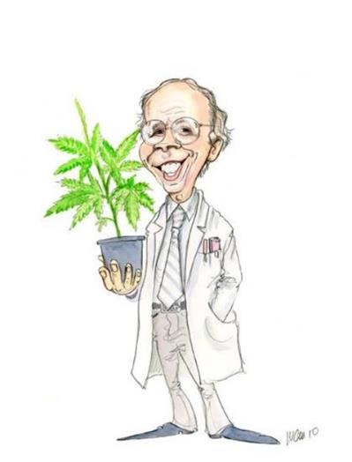
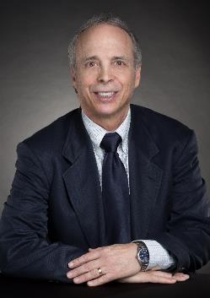
Medical Cannabis Research: Current Challenges & Future Directions
Ethan Russo, MD
Director of Research & Development
ICCI
ethan.russo@icci.science
Copyright 2019
Good day!

Slide 2
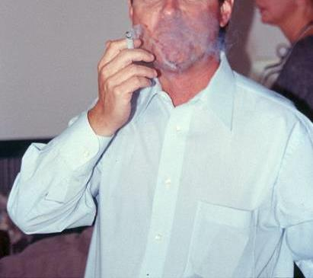
Cannabis Dosing: Smoking
Illegal in most jurisdictions, especially in public
Provokes intoxication
Dose titration not easily achieved
Inefficient and wasteful of THC
Polyaromatic hydrocarbons (PAH) produce premalignant cytological changes
Bronchial irritation inevitable
Can not achieve FDA, or other regulatory approval as a prescription product

Slide 3
Pesticides in Smoked Cannabis
No EPA tolerances are set for pesticides on smoked crops.
Pesticide and growth regulator residues are frequently noted in lab testing of black market cannabis.
~40-70% of toxic residues persist in cannabis smoke.
Sullivan N, Elzinga S, Raber JC. Determination of pesticide residues in cannabis smoke. J Toxicol. 2013:1-6.

Slide 4
The Current Study: Washington State
To more fully assess the current situation, 26 distinct cannabis samples were purchased (24 concentrates, 2 cannabis inflorescence) from legal stores in Washington and passed via witnessed chain of evidence (Seattle Times) to a state certified legal licensed laboratory (Trace Analytics, Spokane, WA).
Russo, E. B. 2016. Current Therapeutic Cannabis Controversies and Clinical Trial Design Issues.
Frontiers in Pharmacology 7:309.

Slide 5
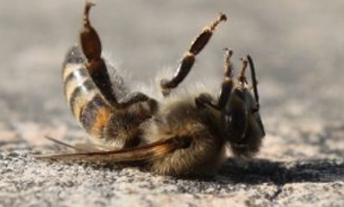
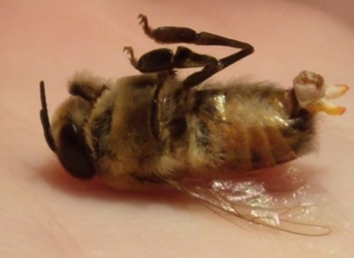
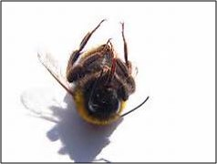
Results:
22/26 samples tested positively for pesticides (84.6%).
Many harbored multiple contaminants, attaining levels in the tens or even hundreds of thousands of parts per billion (ppb), exceeding the upper limit of quantification.
These included 24 distinct pesticide agents: insecticides, miticides, fungicides, an insecticidal synergist and growth regulators, including organophosphates, organochlorides, carbamates, neonicotinoids, etc.
Russo, E. B. 2016. Current Therapeutic Cannabis Controversies and Clinical Trial Design Issues. Frontiers in Pharmacology 7:309.
“She was a good worker!”
RIP
2016-2016
Another drone bites
the dust!
The Queen is dead.
Long live ???

Slide 6
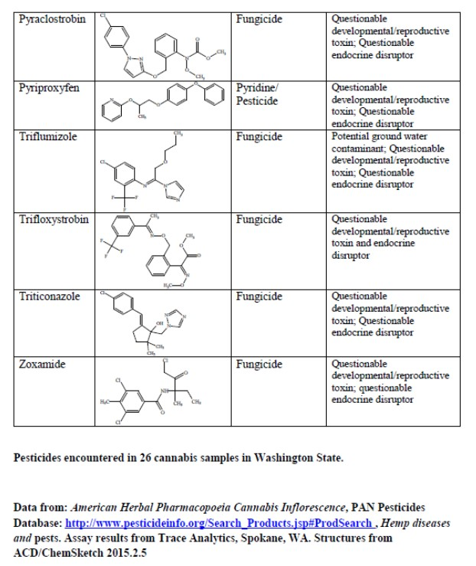
24 Insecticides Isolated from Legal WA Cannabis
Russo, E. B. 2016. Current Therapeutic Cannabis Controversies and Clinical Trial Design Issues.
Frontiers in Pharmacology 7:309.

Slide 7
Carbaryl: a Carbamate Insecticide
BAD ACTOR
Cholinesterase inhibitor
Carcinogen;
Developmental/reproductive toxin
Suspected endocrine disruptor
255X
Russo, E. B. 2016. Current Therapeutic Cannabis Controversies
and Clinical Trial Design Issues. Frontiers in Pharmacology 7:309.

Slide 8
Heavy Metals (Pb, Hg, Cd, Ar)
Cannabis is a bio-accumulator
If heavy metals (lead, mercury, cadmium, arsenic) are present in the soil or medium, they will be recruited into the plant.
This is an advantage for growing hemp as a bioremediation technique, however:
It is deleterious to ingest such material, which must be kept out of the plant for public health reasons.

Slide 9
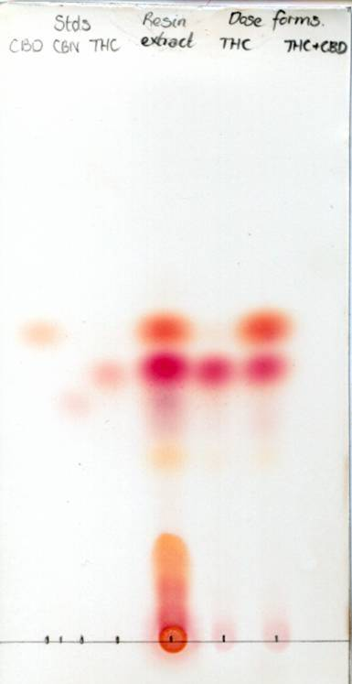
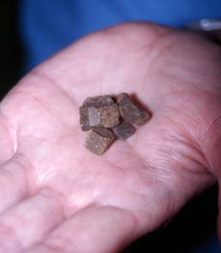
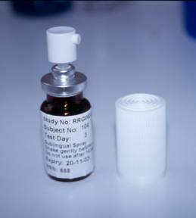
Thin Layer Chromatography of Cannabis Resin vs. nabiximols
nabiximols
Cannabis resin
“soapbar”
nabiximols

Slide 10
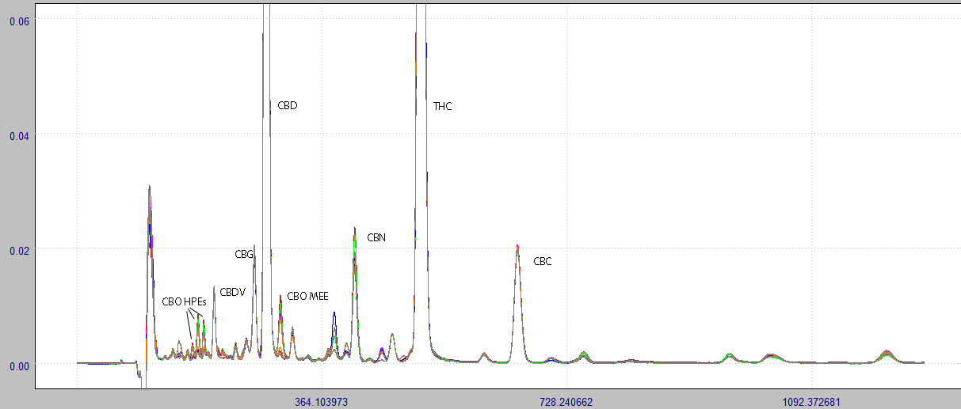
Biochemical Fingerprinting of nabiximols
Full Data
Response
Time (minutes)
Overlay of cannabinoid chromatographic profiles from 25 batches of nabiximols over 9 years
(courtesy of Peter Gibson, PhD, GW Pharmaceuticals)

Slide 11
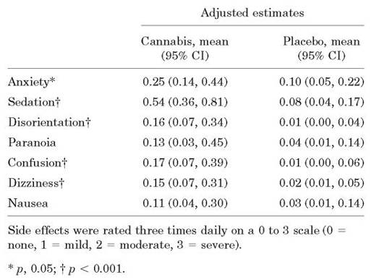
Abrams DI, et al. Cannabis in painful HIV-associated sensory neuropathy: a randomized placebo-controlled trial. Neurology. 2007;68(7):515-21.
Smoked NIDA cannabis in 50 subjects TID for 5 days
All required to have previous cannabis smoking experience
Results
decreased daily pain (p=0.03)
hyperalgesia (p=0.05)
52% with >30% pain reduction vs. placebo (p=0.04)
AEs in smoking group (psychoactive effects) were prominent

Slide 12
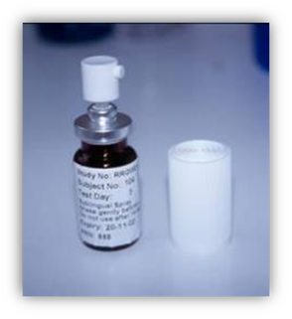
Nabiximols Safety Profile: Adverse Events, Incidence >3%
Most AE’s are early and transient
MacCallum, C. & Russo, E.B. 2018. Practical considerations in cannabis dosing and administration. Europ J Intl Med 49:12-19
Improved safety profile as result of modified “lower and slower” dose titration regimen

Slide 13
Randomized Controlled Trials of nabiximols in Pain
N= | Indication | Duration/Type | Outcome/References
20 | Neurogenic pain | Series of 2-week N-of-1 crossover blocks | Improvement with high-THC extract and nabiximols on VAS pain vs. placebo (p<0.05), symptom control best with nabiximols (p<0.0001) [Wade et al. 2003]
24 | Chronic intractable pain | 12 weeks, series of N-of-1 crossover blocks | VAS pain improved over placebo (p<0.001) especially in MS (p<0.0042) [Notcutt et al. 2004]
48 | Brachial Plexus Avulsion | 6 weeks in 3 two-week crossover blocks | Benefits noted in Box Scale-11 pain scores with high-THC extract (p=0.002) and nabiximols (p=0.005) over placebo [Berman et al. 2004]
66 | Central Neuropathic Pain in MS | 5 weeks | Numerical Rating Scale (NRS) analgesia improved over placebo (p=0.009) [Rog et al. 2005]
125 | Peripheral Neuropathic Pain | 5 weeks | Improvements in NRS pain levels (p=0.004), dynamic allodynia (p=0.042), and punctuate allodynia (p=0.021) vs. placebo [Nurmikko et al. 2007]
56 | Rheumatoid Arthritis | Nocturnal dosing for 5 weeks | Improvements over placebo morning pain on movement (p=0.044), morning pain at rest (p=0.018), DAS-28 (p=0.002), and SF-MPQ pain at present (p=0.016) [Blake et al. 2006]
117 | Pain after spinal injury | 10 days | NSD in NRS pain scores, but improved Brief Pain Inventory (p=0.032), and Patients Global Impression of Change (p=0.001) (unpublished)
177 | Intractable cancer pain | 2 weeks | Improvements in NRS analgesia vs placebo (p=0.0142), THC extract NSD [Johnson, 2010 #6899]
135 | Intractable lower urinary tract symptoms in MS | 8 weeks | Improved bladder severity symptoms including pain over placebo (p=0.001) (unpublished)
360 | Intractable cancer pain | 5 weeks/DB | CRA of lower and middle dose cohorts improved over placebo (p=0.006)/GWCA0701) (Johnson 2010)
Smoked cannabis
RCTs in pain total
3 patient-years
Nabiximols RCTs and
other monitoring total >6000 patient-years
X
Adapted from: Russo EB, Hohmann AG. Role of cannabinoids in pain management. In: Deer T, Gordin V, editors.
Comprehensive Treatment of Chronic Pain by Medical, Interventional and Behavioral Approaches. New York: Springer. 2013:181-197.

Slide 14
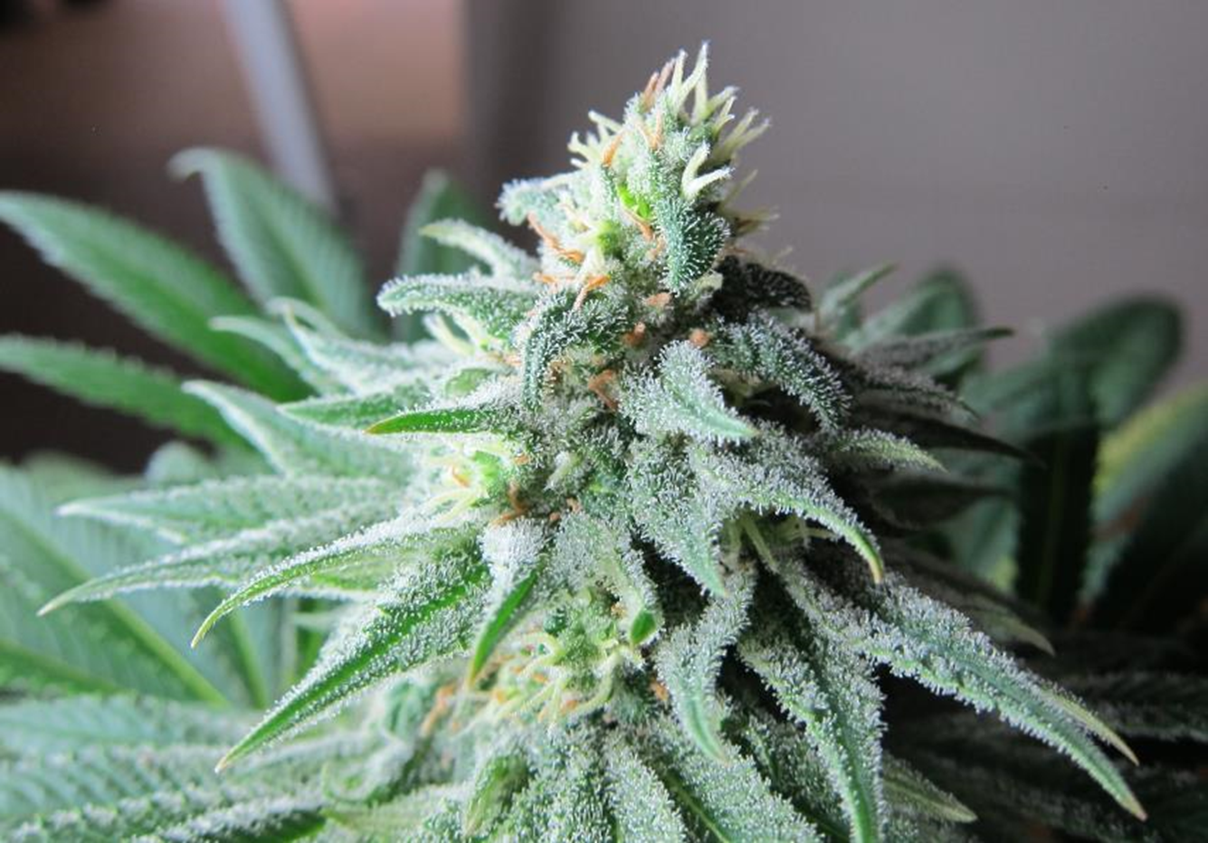
The Future of Cannabis Research
Legalization
Clinical Research
Basic Science Research
Agricultural Research
Food
Fiber
You are
here!
Ustedes
estan
aqui.

Slide 15
The Four Pillars of True Medicine
Efficacy (Phase I-III RCTs)
Safety (RCTs)
Consistency (Standardization)
Accessibility
(Supply Chain & Cost)

Slide 16
Medical Efficacy: Levels of Evidence
Level Type of evidence
I Large RCTs with clear cut results
II Small RCTs with unclear results
III Cohort and case-control studies
IV Historical cohort or case-control studies
V Case series, studies with no controls

Slide 17
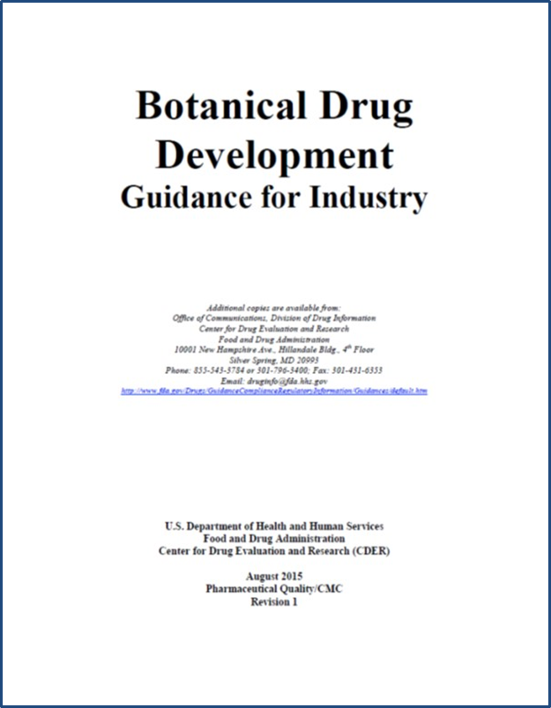
Food and Drug Administration. Guidance for industry: Botanical drug products. US Government. 2015.
Quality
Product Composition
Characterization
Quantification of components
Standardization / Consistency
Stability / Storage
Safety
Animal data, including:
Carcinogenicity
Reproductive toxicology
Chronic toxicology
Genotoxicology
Safety pharmacology
Clinical data
Several hundred patient-years of data required
Reports of all adverse events (mild/moderate/
severe – related and unrelated)
Immediate regulatory notification of SAEs
Efficacy
Multiple Phase II & Phase III placebo-
controlled clinical trials for indication

Slide 18
The Placebo Effect
The mere act of being in a clinical trial generates a certain degree of subjective improvement.
This is aggravated when:
The RCT lacks objective measures (e.g, pain).
The tested drug is psychoactive (e.g., antidepressants & cannabis).
The tested drug has a reputation as “miraculous.”

Slide 19
Tuttle, A. H. et al. 2015. Increasing placebo responses over time in U.S. clinical trials of neuropathic pain. Pain, 156(12), 2616-2626.
Between 1990 & 2013, placebo responses in NP studies increased significantly (p=0.002).
While drug responses in pain in early studies decreased an average of 34.7% from baseline and were stable over time, producing 16.5% greater analgesia than placebo, or 1 point decrease in NRS, by 2013, treatment advantage decreased (p=0.0003) with only an 8.9% decrease in pain over baseline.
Placebo responses increased with sample size (p=0.001), and study length (p=0.05), the worst differences by far in the USA.
FDA requires 12 week RCTs in Phase III in accordance with IMMPACT (Initiative on Methods, Measurement, and Pain Assessment in Clinical Trials) Guidelines (Dworkin 2005), but this may be counterproductive!

Slide 20
Wright S, Duncombe P, Altman DG. Assessment of blinding to treatment allocation in studies of a cannabis-based medicine (Sativex®) in people with multiple sclerosis: a new approach. Trials. 2012;13:189.
No statistical differences were observed in the incidence of Euphoric Mood among patients with prior experience of cannabis vs. those who were cannabis-naïve (3% in each instance)
No differences were noted in the two groups with respect to efficacy of symptom control with nabiximols (Sativex®) (supporting the efficacy of blinding).
Blinding in smoked cannabis studies has been seriously questioned.

Slide 21
Novotna A, et al. A randomized, double-blind, placebo-controlled, parallel-group, enriched-design study of nabiximols* (Sativex®), as add-on therapy, in subjects with refractory spasticity caused by multiple sclerosis. Eur J Neurol. 2011;18(9):1122-31.
Randomized withdrawal design (Part A N=572, Part B N=241). All patients begun on nabiximols (unbeknownst to them).
After 4 weeks, only responders continued.
At resupply visit, half received nabiximols at prior dose.
Half received same number of sprays of placebo.
Mean 48% improvement in spasticity on nabiximols over 16 weeks
Improvement in spasticity numerical rating scale (NRS) favored nabiximols (p=0.0002)

Slide 22
Other Strategies to Reduce the Placebo Effect in Cannabis RCTs
Limit patient expectations: “This drug may or may not help you.”
Treat patients in a neutral fashion.
Avoid ancillary benefits (e.g., free massages at clinic visits).
Utilize a slower delivery technique, i.e., not inhalation, i.e., the preparation must not be overtly psychoactive.
Utilize preparations that attenuate THC psychoactivity with cannabidiol and terpenoid buffers (Russo 2011, 2017).

Slide 23
Inhaled THC vs nabiximols: Comparison of PK Profiles

Slide 24
Tolerance and Intoxication
No evidence of tolerance
Wade DT, Makela PM, House H, Bateman C, Robson PJ. Long-term use of a cannabis-based medicine in the treatment of spasticity and other symptoms in Multiple sclerosis. Multiple Sclerosis. 2006;12:639-645.
Examples: Intoxication Scores
Nabiximols vs THC vs Placebo
 | nabiximols | THC | Placebo
Pre-Dose | 6.45 | 8.22 | 6.59
2 hours | 9.75 | 11.21 | 8.41
4 hours | 9.63 | 12.17 | 7.44

Slide 25
Miller, J., et al. (2005, April 14). A Phase I evaluation of pulmonary dronabinol administered via a pressurized metered dose inhaler in healthy volunteers. American Academy of Neurology, Miami Beach, FL.
Findings:
1) Tachycardia noted with as little as 1.2 mg inhaled THC
2) Psychiatric adverse events noted with as little as 3.6 mg inhaled THC

Slide 26
Ware, M. A., et al (2010). Smoked cannabis for chronic neuropathic pain: a randomized controlled trial. CMAJ, 182(14), E694-701.
21 patients completed an RCT in which 25 mg of cannabis of varying potency was administered in a single inhalation TID for 5 days.
The 9.4% cannabis produced improvements in pain and sleep parameters with reasonable AE profile
Acceptable dosing of cannabis:
9.4% THC X 25 mg X 60% bioavailability =
estimated 1.4 mg inhaled THC per dose

Slide 27
Eisenberg, E. et al. (2014). The pharmacokinetics, efficacy, safety, and ease of use of a novel portable metered-dose inhaler in patients with chronic neuropathic pain: A Phase 1a study. Journal of Pain & Palliative Care Pharmacotherapy, 28, 216-225.
This device was tested employing crushed crude cannabis.
The observed maximum serum concentration of THC (Cmax) of 38 ng/ml is still in the psychoactive range, and would be an issue for regulators, as well as being possibly problematic for THC-naïve patients.
The selected patients with neuropathic pain were a biased population by virtue of already being cannabis patients.
Critics may point out that cannabis users will recognize the high, and confabulate that with reduced pain (whether that is true or not).
The study was unblinded, which would have no weight in the regulatory environment.
A 12-hour abstention from the patients’ customary therapeutic cannabis usage was employed in the trials, and is not long enough to eliminate residual effects on pain threshold from prior use. In most RCTs of clinical application of cannabis, a month of abstinence is mandated.
The pain relief was very brief (about 90 minutes), and use of this technology for a chronic pain patient would require very frequent application, thereby increasing relative risks of reinforcement and dependency. From a drug abuse liability standpoint, this would be unacceptable to most regulators.
The presence or absence of polyaromatic hydrocarbons was not assayed, and would more likely be lower employing a cannabis extract without extraneous plant material.
A 20% device failure was observed without additional explanation or qualification.
This device, as configured, will fail regulatory approval.
Syqe Exo Inhaler
Russo, E. B. (2016). Current Therapeutic Cannabis Controversies and Clinical Trial Design Issues. Front Pharmacol, 7, 309.

Slide 28
Nabiximols Drug Abuse Liability Study
At low doses (4 sprays, containing 10.8mg THC), the abuse liability of nabiximols is not statistically significantly different to that of placebo for the primary endpoints
At mid and high doses (8 & 16 sprays, containing 21.6 & 43.2 mg THC), the abuse liability of nabiximols is not statistically significantly different from THC/dronabinol (20mg and 40mg respectively)
At high dose (16 sprays) nabiximols is not significantly different from low dose THC/dronabinol (data not shown)
But…for all measures, nabiximols < THC/dronabinol
Schoedel, K. A., et al. (2011). A randomized, double-blind, placebo-controlled, crossover study to evaluate the subjective abuse potential and cognitive effects of nabiximols oromucosal spray in subjects with a history of recreational cannabis use. Hum Psychopharmacol, 26, 224-36.

Slide 29
What’s Wrong with Current Herbal Cannabis Clinical Trials?
They are too short in duration.
They are too small in size.
Use of unstandardized cannabis preparations (USA, Israel and elsewhere) renders the results unreproducible.
Blinding has been largely inadequate.
They do not advance the regulatory process (i.e., approval as a pharmaceutical) at all.

Slide 30
Cannabis Efficacy: Where Are We Now?
Solid clinical trial proof for cannabinoid therapy exists for either cannabis-based medicines, THC or CB₁ agonists:
Nausea and vomiting
Anorexia associated with chemotherapy, HIV/AIDS
Spasticity in multiple sclerosis and other neurological conditions
Neuropathic pain, whether peripheral or central
Cancer pain
Lower urinary tract symptoms (LUTS)
Glaucoma (no recent RCTs)
For cannabidiol (CBD):
Intractable epilepsy (Dravet & Lennox-Gastaut syndromes)
(multiple Phase III RCTs)
Schizophrenia, positive and negative symptoms (2 Phase II RCTs)

Slide 31
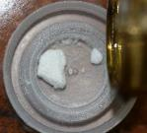
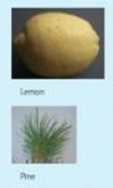
Problems in Cannabis Laboratory Analysis
Hampered by illegality: Lack of Schedule I permits (USA)
Lack of uniformity in methodology
Poor application of due diligence, “dry-lab results”
Dearth of cannabinoid standards
Cannabinoids are tough to assay properly
Terpenoids are even tougher

Slide 32
Clinical Cannabis Research
Pros:
Legalization will open doors:
Attitude Shift
Reduced black market crime
Federally regulated medical production programs
Some good THC genetics available to develop and formulate medicines
Interested and informed clinicians available, if sparsely, in some areas
Cons:
Large country
Centralized medical care a problem for recruiting rural clientele to RCTs
Why should patients enter a clinical trial when cannabis is already available?
Poor biochemical diversity of chemovars
Vestiges of unconvinced politicians and doctors
300 kg political gorilla!

Slide 33
Clinical Research Priorities
Pain and Inflammation, particularly unstudied conditions
Arthritis, both rheumatoid and osteoarthritis
Inflammatory bowel disease (Crohn, ulcerative colitis)
Metabolic syndrome/insulin resistance
Dermatology: acne, psoriasis, contact dermatitis
Neuroprotection in Alzheimer, dementia, TBI, CVA, CTE
PTSD and other psychiatric conditions
Treatment of addiction/dependency
Optimizing ECS health
Lifestyle and nutritional research
}
Reduce cannabis need

Slide 34
Cannabis Basic Science Research
Needs:
Breeding expertise
Genetics
Genomics
Ascertaining cannabinoid and terpenoid metabolic pathways
Optimizing cannabis component ratios
Seed commerce
Issues:
Organic culture vs. GMO
Pesticides
Heavy Metals
Microbiological contaminants
Knowledge deficit in medical schools
Opposition of hierarchies (insurers/medical societies)

Slide 35
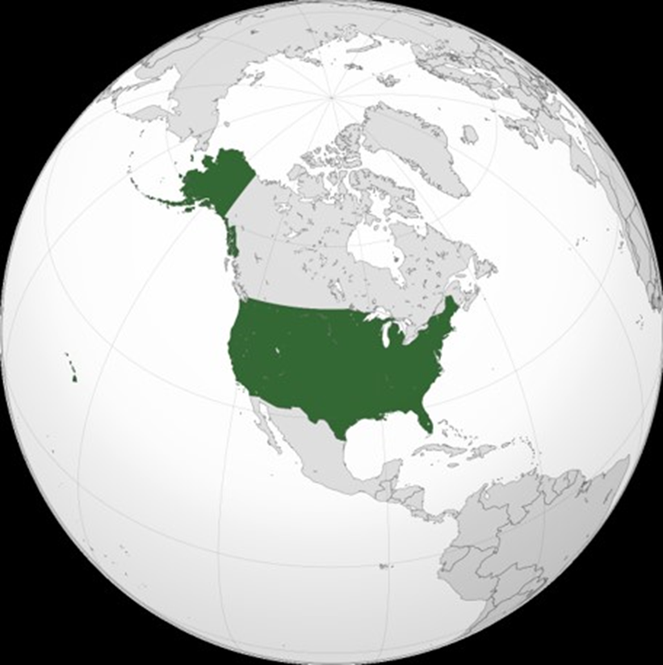
Cannabis Research: 10 Years Hence
An over-achiever in basic science
A world leader in clinical cannabis therapeutics, fiber production, hemp seed nutrition and cannabis-based cosmetics
The Crystal Ball
by
John William Waterhouse

Slide 36
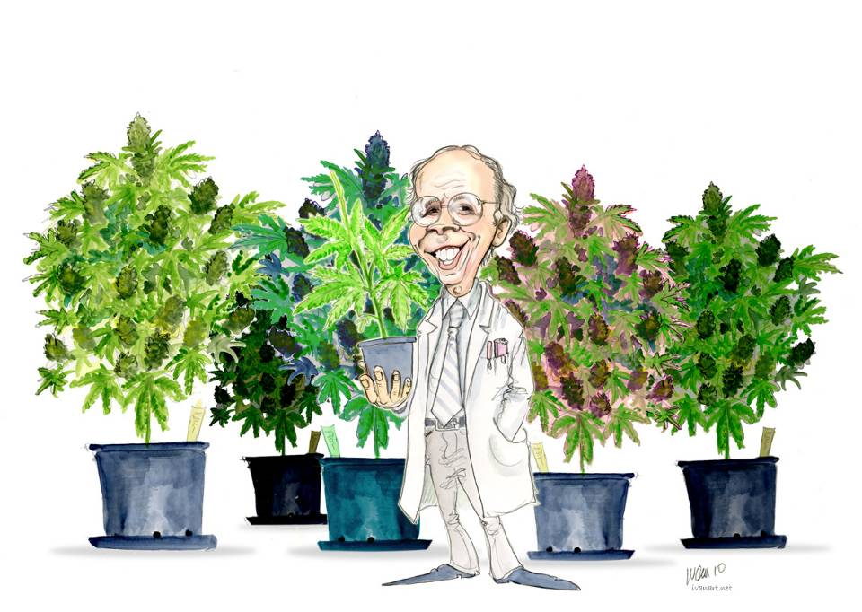
Questions?
IvanArt, Bern, Switzerland, 2010 http://www.ivanart.net/index.html

