Slide 1
MUSC
College of Medicine
Appointments, Promotion, and Tenure
Process and Procedures

Slide 2
Promotion Process
Packets send to APT committee
Packets distributed to Subcommittees
Subcommittee chair assigns reviewers
Subcommittee meets and recommends approval, disapproval or deferral
Disapprovals and deferrals are reported to department chairs for additional information and rebuttal
Full committee meets and discusses packets with votes for approval/disapproval recommendations
Recommendations for disapproval are reported to the chairs with invitation to address the Committee in person
Final Committee meeting determines final recommendations for the Dean

Slide 4
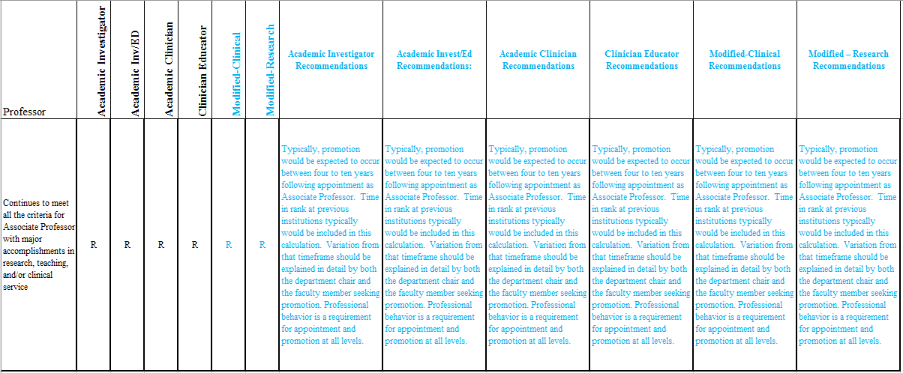
Associate to Professor

Slide 5
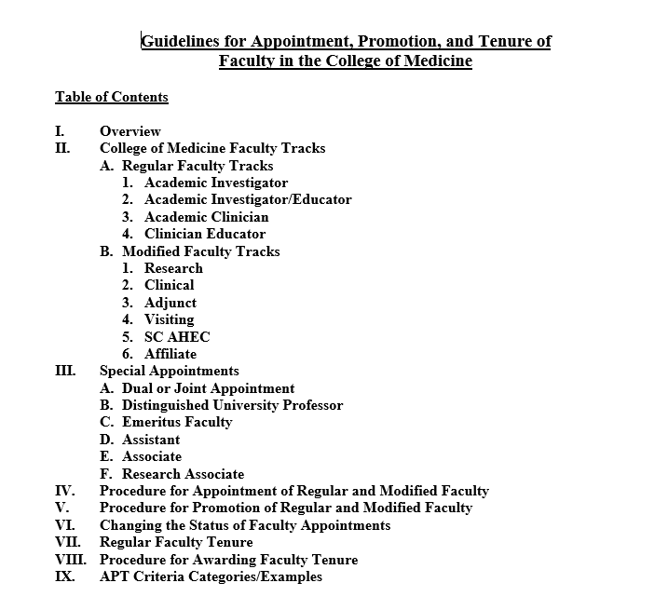
Approved by BOT May 17, 2024

Slide 6
Faculty Tracks
Regular (4 with potential for tenure)
  Academic Investigator
  Academic Investigator / Educator
  Academic Clinician
  Clinician Educator
Modified (4 without potential for tenure)
  Research Faculty
  Clinical Faculty

Slide 7
Academic Investigator
For appointment as an Assistant Professor in this track, faculty are expected to have the appropriate training and attributes to enable them to excel in Research/Scholarship. For promotion from Assistant to Associate Professor (or for an initial MUSC appointment as Associate Professor), faculty members must demonstrate excellence in Research/Scholarship, and evidence of achievement in either Education/Teaching or Service/Leadership at the assistant professor rank, but participation in both is expected. For promotion to Professor (or for an initial MUSC appointment as Professor), faculty members must demonstrate excellence in Research/Scholarship and evidence of sustained achievement in Education/Teaching and Service/Leadership at the associate professor rank.

Slide 8
Research/Scholarship
The following Research/Scholarship criteria are what the APT Committee might consider to be “typical” standards for appointment/promotion in this track (with understanding that some candidates will have scholarly productivity that is not typical). With respect to publications, a typical candidate for promotion will have 5 or more peer-reviewed primary research publications since last appointment/promotion with a significant authorship role (first or last authorship is assumed to be significant, as is corresponding authorship; the significance of contribution in cases of other positions of authorship must be explained). Exceptions could be made for impactful publications in the field (as supported by statements from external references or number of citations); patents filed based on the published work; honors/awards specifically for the published work; etc.

Slide 9
Education/Teaching
Formal classroom teaching in the medical or graduate school curricula and serving as a course director have the most weight. Classroom teaching can include didactic lectures, leading discussion groups in student-led learning or problem-based learning, presentation of CME lectures, etc. Direct mentoring of trainees at all levels in the candidate’s lab is an important component of Teaching but has lesser weight than classroom teaching because this is so deeply intertwined with Research/Scholarship. Membership on student qualifying exam or thesis committees falls within Teaching but is of even lower weight.

Slide 10
Service/Leadership
Service includes activities within and external to the University. Common internal service roles include membership on committees at any level. External service commonly includes study section membership, conference organization, etc. Roles that involve a higher degree of leadership or responsibility should be identified as such. Because all of these can vary so widely in their scope of effort and responsibility, it is the responsibility of the candidate for promotion to provide sufficient information to the APT Committee to explain their roles in these service activities and to justify that their activities meet the criteria for participation vs. achievement vs. excellence.

Slide 11
2. ACADEMIC INVESTIGATOR/EDUCATOR
For promotion from Assistant to Associate Professor (or for an initial MUSC appointment as Associate Professor), faculty members must demonstrate excellence in Education/Teaching, and evidence of achievement in either Research/Scholarship or Service/Leadership at the assistant professor rank, but participation in both is expected. For promotion to Professor (or for an initial MUSC appointment as Professor), faculty members must demonstrate excellence in Education/Teaching and evidence of sustained achievement in Research/Scholarship and Service/Leadership at the associate professor rank.

Slide 12
Education/Teaching
Formal classroom teaching in the medical or graduate school curricula and serving as a course director have the most weight. Classroom teaching can include didactic lectures, leading discussion groups in student-led learning or problem-based learning, presentation of CME lectures, etc. Direct mentoring of trainees at all levels in the candidate’s lab is an important component of Education/Teaching but has lesser weight than classroom teaching because this is so deeply intertwined with Research/Scholarship. Membership on student qualifying exam or thesis committees falls within Education/Teaching but is of even lower weight.

Slide 13
Research/Scholarship
The following Research/Scholarship criteria are what the APT Committee might consider to be “typical” standards for appointment/promotion in this track (with understanding that some candidates will have scholarly productivity that is not typical). With respect to publications, a typical candidate for promotion will have 5 or more peer-reviewed academic publications since last appointment/promotion. Review papers, commentaries, case reports, book chapters, textbooks, and other types of publications are recognized to have merit in scholarship, and the type of publication for each publication listed as a scholarship accomplishment must be explicitly identified.

Slide 14
Service/Leadership
Service/Leadership includes activities within and external to the University. Common internal service roles include membership on committees at any level. External service commonly includes study section membership, conference organization, etc. Roles that involve a higher degree of leadership or responsibility should be identified as such. Because all of these can vary so widely in their scope of effort and responsibility, it is the responsibility of the candidate for promotion to provide sufficient information to the APT Committee to explain their roles in these service activities and to justify that their activities meet the criteria for participation vs. achievement vs. excellence.

Slide 15
3. ACADEMIC CLINICIAN
For promotion from Assistant to Associate Professor (or for an initial MUSC appointment as Associate Professor), faculty members must demonstrate excellence in Clinical Service and Research/Scholarship, and evidence of achievement in either Education/Teaching or Service/Leadership at the assistant professor rank, but participation in both is expected. For promotion to Professor (or for an initial MUSC appointment as Professor), faculty members must demonstrate excellence in Clinical Service and Research/Scholarship, and evidence of sustained achievement in Education/Teaching or Service/Leadership at the associate professor rank, but participation in both is expected.

Slide 16
Research/Scholarship
The following Research/Scholarship criteria are what the APT Committee might consider to be “typical” standards for appointment/promotion in this track (with understanding that some candidates will have scholarly productivity that is not typical). With respect to publications, a typical candidate for promotion will have 5 or more peer-reviewed primary research publications since last appointment/promotion with a significant authorship role (first or last authorship is assumed to be significant, as is corresponding authorship; the significance of contribution in cases of other positions of authorship must be explained). Exceptions could be made for impactful publications in the field (as supported by statements from external references or number of citations); patents filed based on the published work; honors/awards specifically for the published work; etc. The impact factor of the journal is a consideration but not an absolute criteria of significance or impact of the publication.

Slide 17
Research/Scholarship
With respect to funding, it would be unusual for a candidate for promotion to not hold current grant support. For promotion to Full Professor, evidence of sustained grant support is expected. A typical candidate for promotion will currently serve as PI or MPI on an NIH R01 or similar extramural award. Foundation grants and grants from industry are recognized as alternative sources of research support although usually of a lesser significance than an NIH R01

Slide 18
Clinical Service
Influencing Clinical Practice such as development of innovative approaches to diagnosis, treatment, or prevention of disease, applications of technologies and/or models of care delivery that are recognized for influencing care at a regional and/or national level. Recognition as a Clinical Expert such as visiting professorships and invitations to speak nationally and, in some cases, internationally on issues related to area of clinical expertise. Leadership roles in national and, in some cases, international professional organizations related to an area of clinical expertise including leadership of national and/or international courses or programs.

Slide 19
Education/Teaching
Formal classroom teaching in the medical or graduate school curricula and serving as a course director have the most weight. Classroom teaching can include didactic lectures, leading discussion groups in student-led learning or problem-based learning, presentation of CME lectures, etc. Direct mentoring of trainees at all levels in the candidate’s lab is an important component of Education/Teaching but has lesser weight than classroom teaching because this is so deeply intertwined with Research/Scholarship. Membership on student qualifying exam or thesis committees falls within Education/Teaching but is of even lower weight.

Slide 20
Service/Leadership
Service includes activities within and external to the University. Common internal service roles include membership on committees at any level. External service commonly includes study section membership, conference organization, etc. Roles that involve a higher degree of leadership or responsibility should be identified as such. Because all of these can vary so widely in their scope of effort and responsibility, it is the responsibility of the candidate for promotion to provide sufficient information to the APT Committee to explain their roles in these service activities and to justify that their activities meet the criteria for participation vs. achievement vs. excellence.

Slide 21
4. CLINICIAN EDUCATOR
For appointment as an Assistant Professor in this track, faculty are expected to have the appropriate training and attributes to enable them to excel in Clinical Service and Education/Teaching. For promotion from Assistant to Associate Professor (or for an initial MUSC appointment as Associate Professor), faculty members must demonstrate excellence in Clinical Service and Education/Teaching at the assistant professor rank, and evidence of participation in either Research/Scholarship or Service/Leadership. For promotion to Professor (or for an initial MUSC appointment as Professor), faculty members must demonstrate excellence in Clinical Service and Education/Teaching at the associate professor rank, and evidence of sustained achievement in Research/Scholarship or Service/Leadership, but participation in both is expected.

Slide 22
Education/Teaching
Formal classroom teaching in the medical or graduate school curricula and serving as a course director have the most weight. Classroom teaching can include didactic lectures, leading discussion groups in student-led learning or problem-based learning, presentation of CME lectures, etc. Direct mentoring of trainees at all levels in the candidate’s lab is an important component of Education/Teaching but has lesser weight than classroom teaching because this is so deeply intertwined with Research/Scholarship. Membership on student qualifying exam or thesis committees falls within Education/Teaching but is of even lower weight. This list is not intended to be comprehensive; other forms of Education/Teaching certainly have merit.

Slide 23
Clinical Service
Influencing Clinical Practice such as development of innovative approaches to diagnosis, treatment, or prevention of disease, applications of technologies and/or models of care delivery that are recognized for influencing care at a regional and/or national level. Recognition as a Clinical Expert such as visiting professorships and invitations to speak nationally and, in some cases, internationally on issues related to area of clinical expertise. Leadership roles in national and, in some cases, international professional organizations related to an area of clinical expertise including leadership of national and/or international courses or programs.

Slide 24
Research/Scholarship
The following Research/Scholarship criteria are what the APT Committee might consider to be “typical” standards for appointment/promotion in this track (with understanding that some candidates will have scholarly productivity that is not typical). With respect to publications, a typical candidate for promotion will have 5 or more peer-reviewed primary research publications since last appointment/promotion. Review papers, commentaries, case reports, book chapters, textbooks, and other types of publications are recognized to have merit in scholarship although usually of a lesser impact than primary research papers, and the type of publication for each publication listed as a scholarship accomplishment must be explicitly identified.

Slide 25
Service/Leadership
Service includes activities within and external to the University. Common internal service roles include membership on committees at any level. External service commonly includes study section membership, conference organization, etc. Roles that involve a higher degree of leadership or responsibility should be identified as such. Because all of these can vary so widely in their scope of effort and responsibility, it is the responsibility of the candidate for promotion to provide sufficient information to the APT Committee to explain their roles in these service activities and to justify that their activities meet the criteria for participation vs. achievement vs. excellence.

Slide 26
Modified Research
For promotion from Assistant to Associate Professor (or for an initial MUSC appointment as Associate Professor), faculty members must demonstrate significant achievement in Research/Scholarship at the assistant professor rank. For promotion to Professor (or for an initial MUSC appointment as Professor), faculty members must demonstrate excellence in Research/Scholarship at the associate professor rank.

Slide 27
Modified Clinical
For appointment as an Assistant Professor in this track, faculty are expected to have the appropriate training and attributes to enable them to support the Clinical Service mission. For promotion from Assistant to Associate Professor (or for an initial MUSC appointment as Associate Professor), faculty members must demonstrate significant achievement in Clinical Service and participation in Education/Teaching at the assistant professor rank. For promotion to Professor (or for an initial MUSC appointment as Professor), faculty members must demonstrate excellence in Clinical Service and demonstrate achievement in Education/Teaching at the associate professor rank.

Slide 28
Availability
https://horseshoe.musc.edu/university/colleges/com/faculty/apt-committee
Faculty Roundtables
Annual Department meetings

